Slide 1


Neighborhood Watch
Notes:
Amanda to welcome everyone and kick-off the evening.

Slide 2
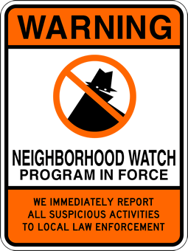
What is Neighborhood Watch
A Crime Prevention Program that enlists resident participation & involvement in a Police-Community collaborative battle against neighborhood crime
Our primary purpose is personal and property protection for neighborhoods & residents by knowing your neighbors and working together in a program of mutual assistance
It is an extension of the “eyes & ears” of the Police Department and about crime prevention education and the implementation of important home and personal security strategies
Governed by the Police Department and a Board of Directors, with the assistance of Block Captains

Slide 3
What is a Block Captain?
A Block Captain is NOT…
A volunteer
A conduit to receive and relay information to and from neighbors, and the community at large, to and from the Police Department
A point person for their block to foster the benefits of Neighborhood Watch
Provide safety & security information and advice on defensive measures and to provide advice on what to report
Law Enforcement
A vigilante
An authority in a criminal situation
Authorized or encouraged to become physically involved in a crime in progress
A neighborhood gofer

Slide 4
Block Captain Responsibilities
Organize your block. To be a recognized Neighborhood Watch Block, there needs to be a Block Captain.
Know your neighbors! Meet current residents and welcome new ones.
Attend and/or host neighborhood/community meetings & events. Encourage block participation.
Actively promote the ideals of Neighborhood Watch.
Provide neighbors with information and resources provided by the Police Department.
Time commitment is minimal and as needed

Slide 5

Your involvement will directly affect the crime rate of your neighborhoods!
CRIME
On average, Neighborhood Watch Blocks are 84% safer than non-Neighborhood Watch Blocks
Attributed to appearing “occupied”, meaning your neighborhoods look “lived in”, people coming and going, knowing what’s going on and who belongs; therefore, creating a riskier environment for crooks to target
Areas with the highest crime rates are the most reluctant to organize
“SEE SOMETHING, SAY SOMETHING!”

Slide 6
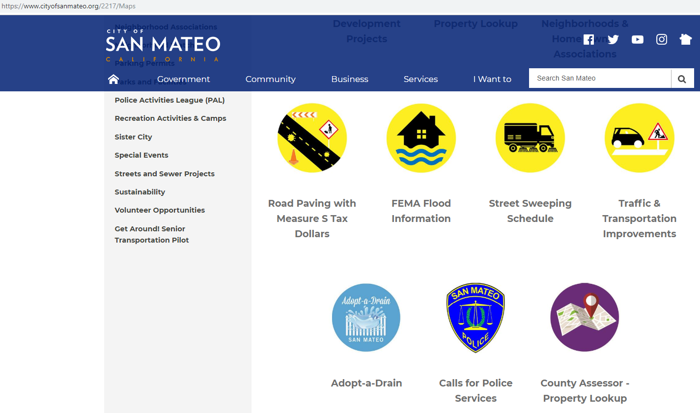
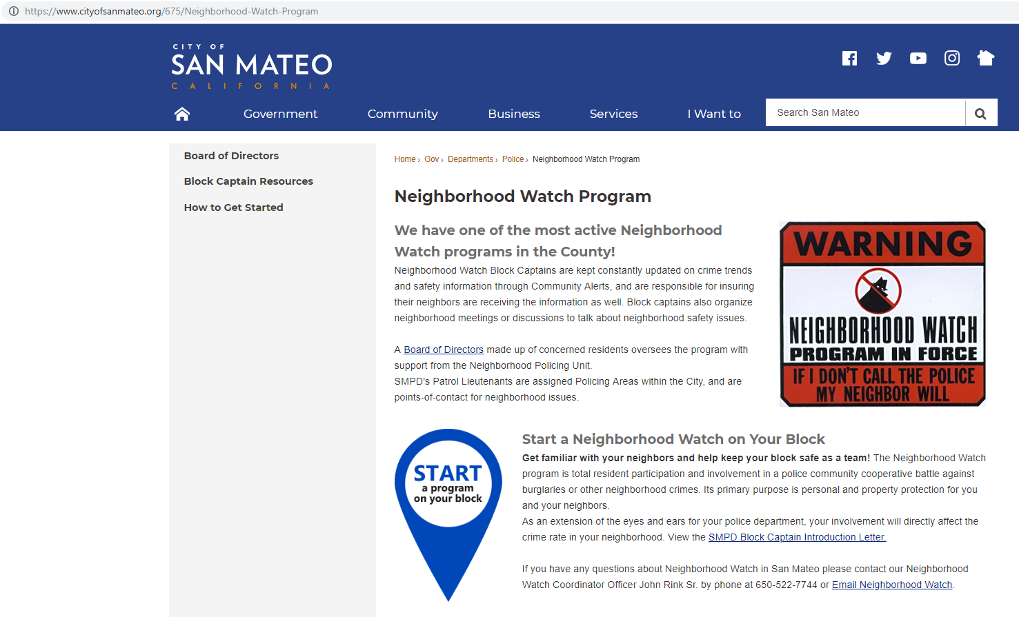

www.cityofsanmateo.org/675/Neighborhood-Watch-Program
https://www.cityofsanmateo.org/2217/Maps

Slide 7
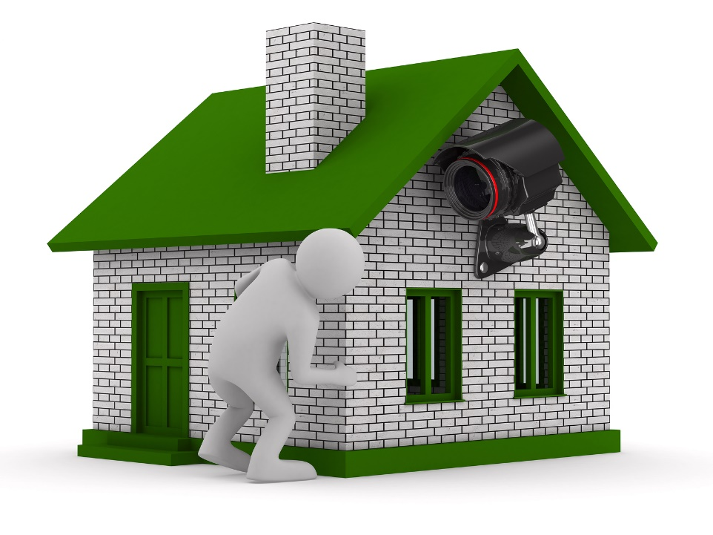
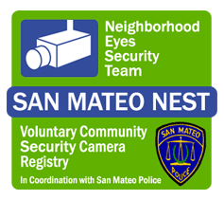
San Mateo NEST (Neighborhood Eyes Security Team)
This voluntary registry simply informs the PD of the locations of home security cameras in the city. We do not have access, remote or otherwise, to your personal property. This simply aids the PD in locating potential video evidence in the event an incident occurs in a residential neighborhood.
Register your Home Security Cameras at www.tinyurl.com/smpdnest
Notes:
Amanda & Jeanine

Slide 8
Stay Connected
Follow us on our Social Media & Alert Platforms
Social Media
Twitter (@SanMateoPD)
Facebook (@CityofSanMateoPD)
Instagram (sanmateopd)
YouTube (San Mateo Police Department)
Alert & Communication Platforms
Nextdoor.com (Neighborhood Social Media)
Nixle (Critical text and email alerts)
  -Text your zip code to 888777 or
  -Visit nixle.com/san-mateo-ca-police-department
Rapid Notify/Rave Mobile (Reverse 9-1-1)
  -http://www.cityofsanmateo.org/index.aspx?nid=2941
SMC Alert (County alerts)
  -www.tinyurl.com/smcalerts
Follow us on all of our Social Media and Alert platforms
Contact us at: (650)522-7791 or neighborhoodwatch@cityofsanmateo.org
Keep a Roster
Be a Good Witness
Be a Nextdoor Ambassador
Notes:
Amanda & Jeanine

